Slide 1
Meaningful Meetings
Oxymoron? Not Anymore!

Slide 2
“Consider that there is a way of listening that allows people to speak authentically, a way of speaking that engages and influences the thinking of others, and a way of managing the conversation that leads to higher levels of accomplishment.”
- Paul Axtell

Slide 3



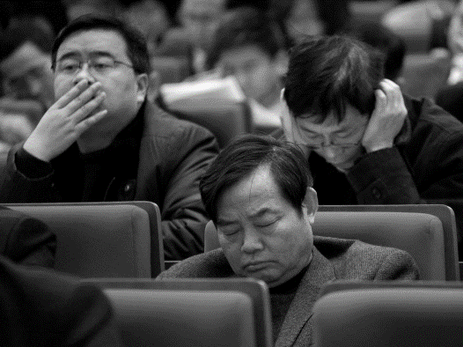

Slide 4

Conversation Points
CONVERSATION
Clarity
Candor
Commitment
Completion

Slide 5
Meeting Objectives
1
2
3
Accomplish agenda
Manage conversation
Get better over time

Slide 6

GROUND RULES
Timeliness
Clarity
Full Participation
Respect views
Okay to disagree
Presence
Silence denotes agreement and alignment

Slide 7
Meeting Designs
Starting a project
  Define overall outcomes
  Describe what success looks like
  Set milestones to measure progress
  Determine resources
  Define stakeholders
  First few weeks detailed
  Frequency of check in

Slide 8
Meeting Designs
Checking progress
  Clarify status of elements
  Status against targets
  Next steps with commitments

Slide 9
Meeting Designs
Requesting input
  Describe situation
  Ask questions, create discussion
  Acknowledge (and listen)
  Check in with everyone
  Summarize takeaways
  Explain steps
  Ask for concerns or reservations

Slide 10
Meeting Designs
Respond to problem
  Describe situation
  List questions
  Define considerations and criteria
  Explore options
  Action items

Slide 11
Meeting Designs
Making a decision
  State desired outcome
  Discuss decision rights and process
  Outline criteria of success
  Define all options (and ups and downs of each)
  Decide and align
  Identify conversations to have
  Define next few weeks

Slide 12
Meeting Designs
Creating Alignment
  Clear outcome and path
  Open ended questions
  Agree to express differing views
  Clarify value – and concerns
  “Anything missing?”
  Address concerns and requests

Slide 13
Closure
Completion
Alignment
Next steps
Value / Thanks

Slide 14
Trouble with Agendas
Not distributed in advance
No stated purpose
Too many items
No time for the big stuff
Discuss, but don’t decide
Sidetracked with distractions

Slide 15
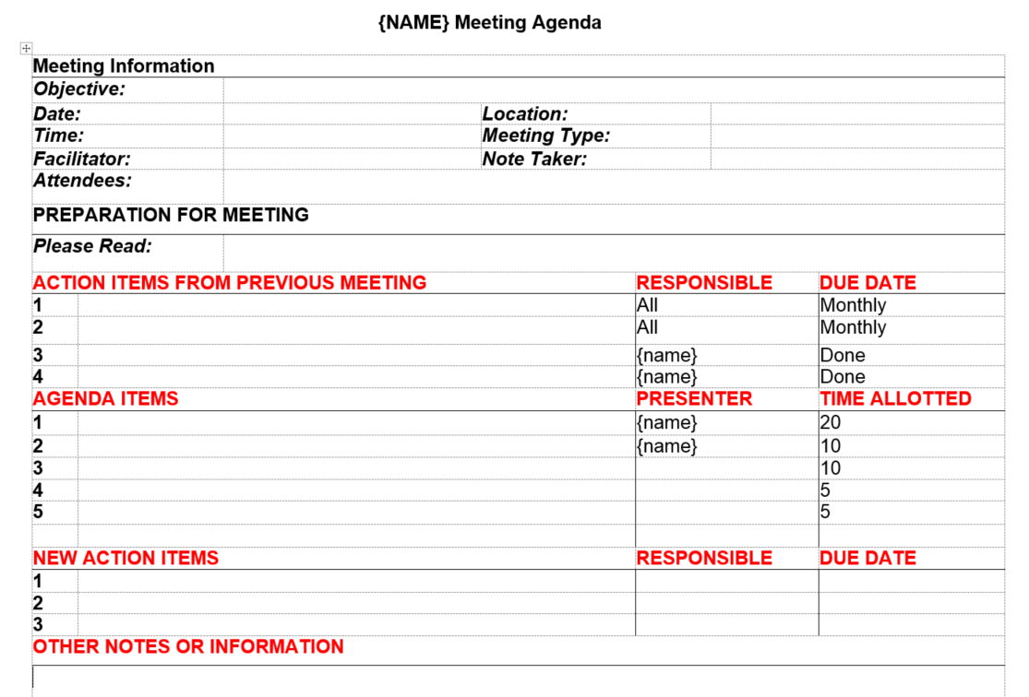
Objective: Include purpose when agenda is distributed and at meeting inception. May differ by topics
Note Taker:
Difficult to lead and capture comments (action items)
Read: What should be read before the meeting and why
Action Items: Minutes within 24 hours; Nothing slips through cracks if listed
Agenda: sequence by importance, length, purpose, or leader
Presenter: Differs by topic; engages participants and allows leader to focus elsewhere
Time: Varies by topic but keeps meeting on track

Slide 16
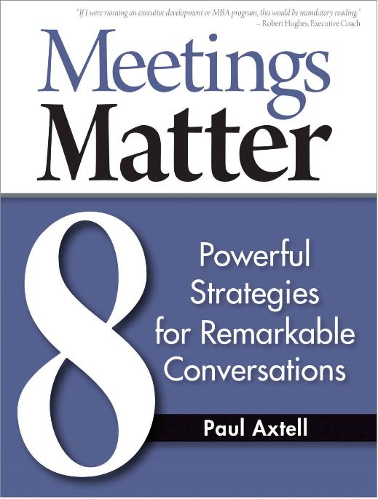

Slide 17
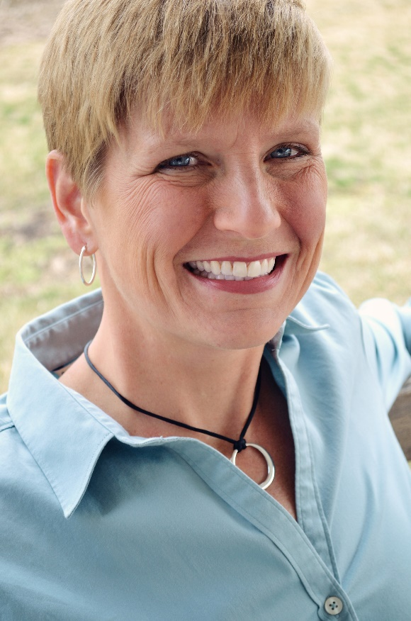




About the Speaker
Judy Hissong is the President of Nesso Strategies. Judy is passionate, entertaining, and outcome driven in preparing and delivering tailored programs for her clients. She is a PCC-level accredited coach and an ACE-certified personal trainer, bringing the mind and body together in her powerful leadership messages.
619.546.7885
www.linkedin.com/in/judyhissong/
Judy@NessoStrategies.com
@judyhissong

Slide 18
Your role
Listen
Aware
Notice

Slide 19
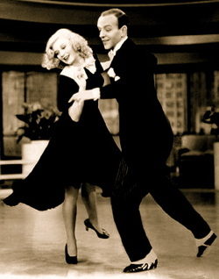
Fred Astaire said,
“It took 15 years to make it look easy.”

